Slide 1
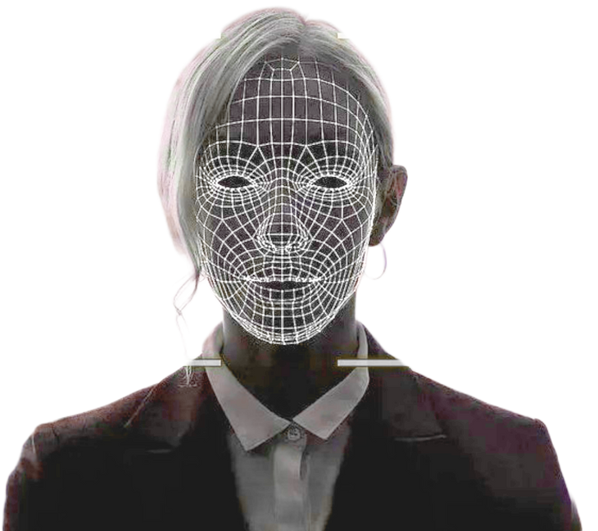
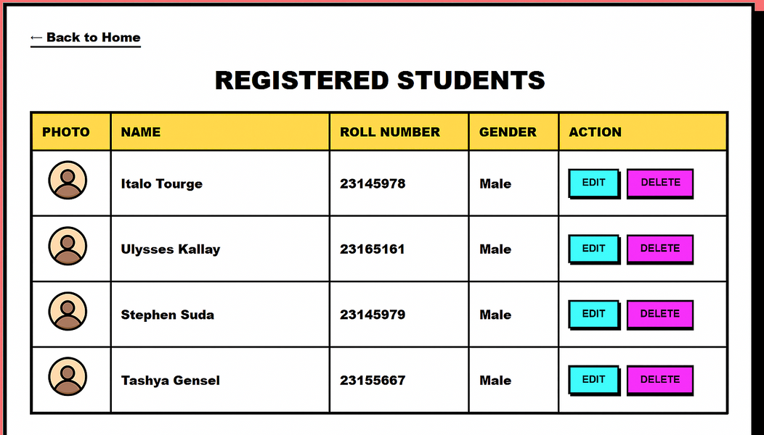

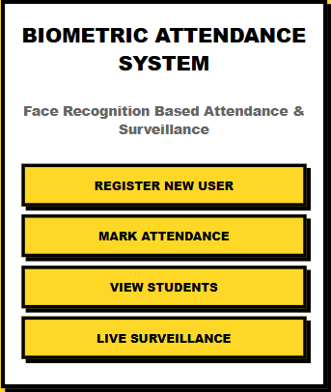
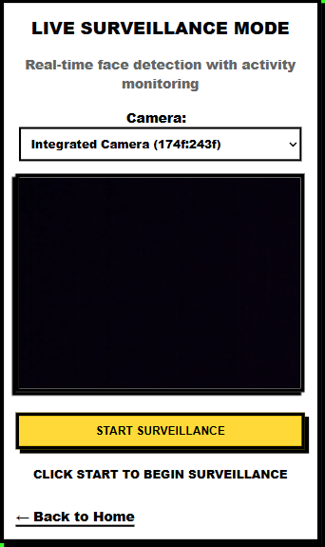
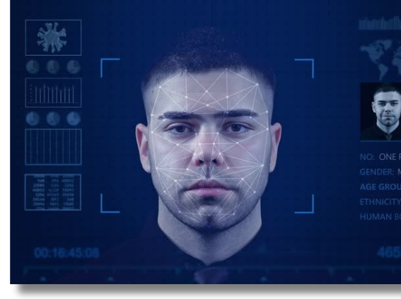
Live Face Attendance System

Slide 2


CONTENTS
01
04
Project Overview
System Features
02
05
Deployment & Impact
ML Pipeline
03
06
Model Evaluation
Demo & Testing

Slide 3
01 Project Overview
Smart Attendance Vision
This project aims to automate the student attendance process using facial recognition technology.
The system detects and recognizes faces in real-time through a webcam, eliminating the need for manual or card-based attendance.
It is built using Python, Flask, TensorFlow, and DeepFace, with FaceNet as the core model for face recognition.
The model achieves 100% accuracy with zero false acceptance and rejection rates.
Includes liveness detection using the Eye Aspect Ratio (EAR) algorithm to prevent photo-based spoofing.
Data is stored securely in JSON and CSV formats, ensuring privacy and easy record management.
Designed to be scalable, fast, and contactless, suitable for schools, colleges, and workplaces.

Slide 4



Core Technologies Stack
Backend & ML
Frontend & Data
Deployment
Python, Flask, TensorFlow, DeepFace, OpenCV, and MediaPipe.
HTML, CSS, JavaScript, and lightweight JSON storage.
CPU-optimized pipeline runs on any 4GB RAM machine.

Slide 5
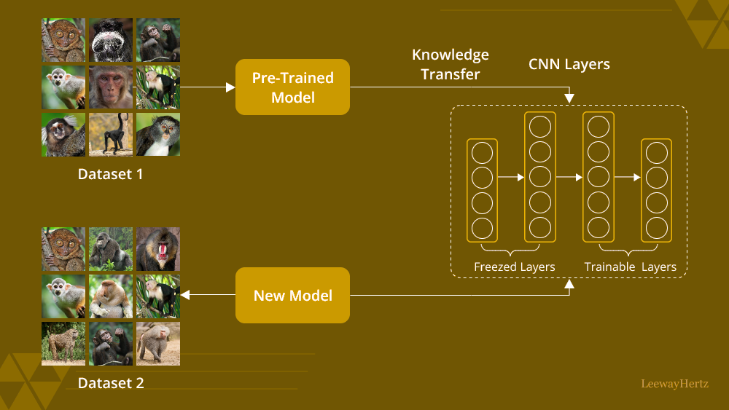



02 ML Pipeline
Transfer Learning Choice
We selected FaceNet, pretrained on 200M faces, and fine-tuned it via an InceptionResNetV2 backbone.
Base Accuracy: 99.63%
Total Parameters: 54M
Trainable Params: 329K

Slide 6
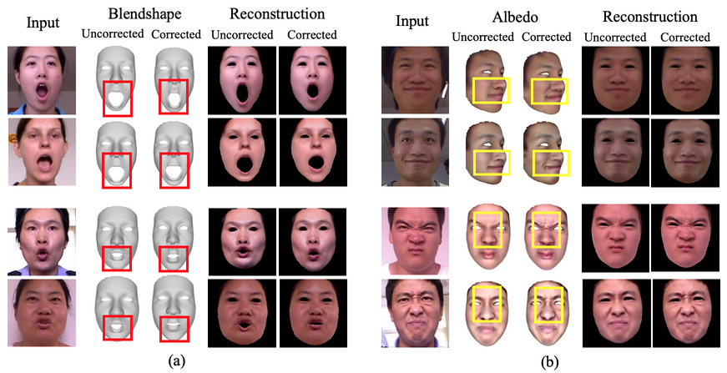






Data Augmentation Engine
Four original images expanded to 200+ training samples.
Rotation ±20°
Width Shift ±20%
Height Shift ±20%
Zoom ±20%
Horizontal Flip
Shear ±20%

Slide 7
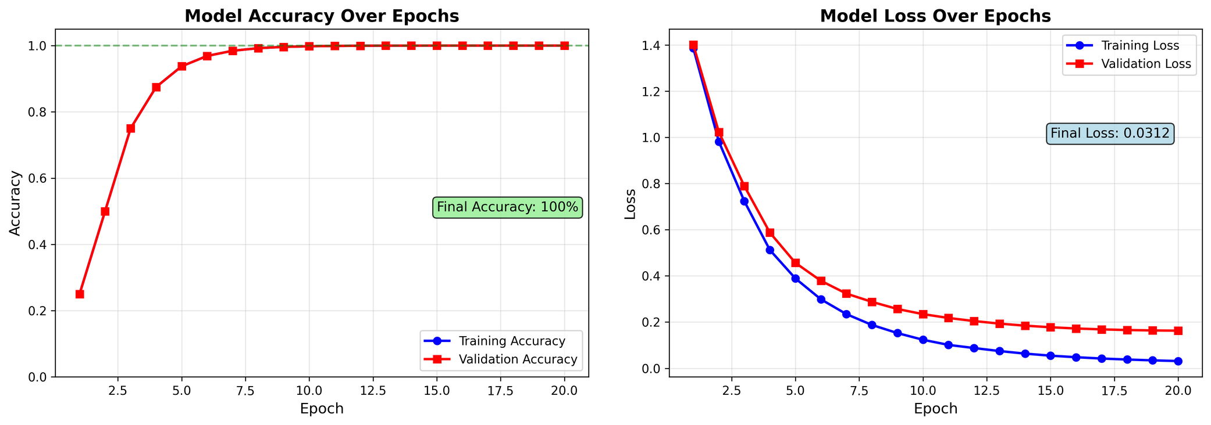
Training Performance Curve
Adam optimizer, batch size 8, 20 epochs, 20% validation split.
Training Accuracy
Validation Accuracy
Training Loss
25% → 100%
100%
1.38 → 0.03

Slide 8
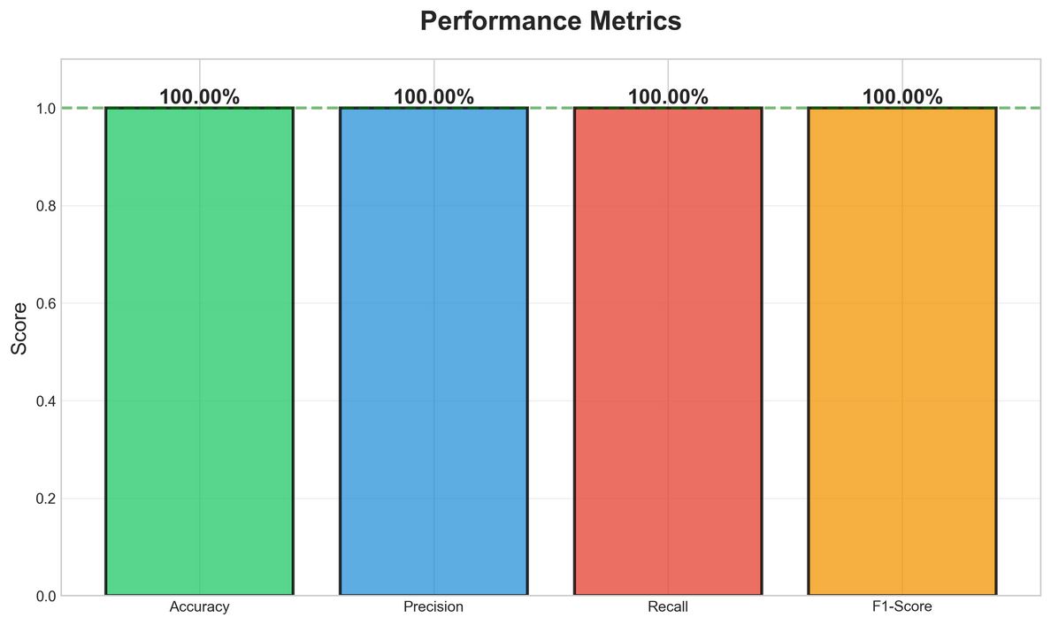
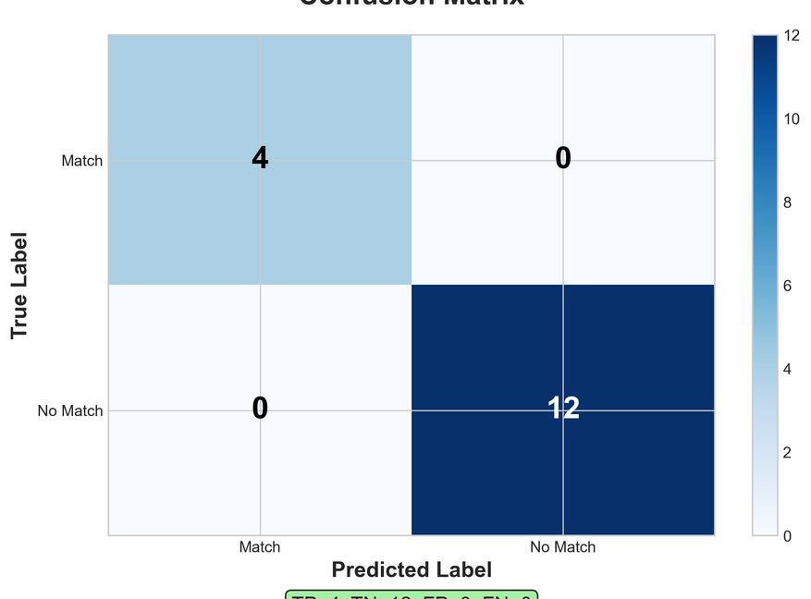
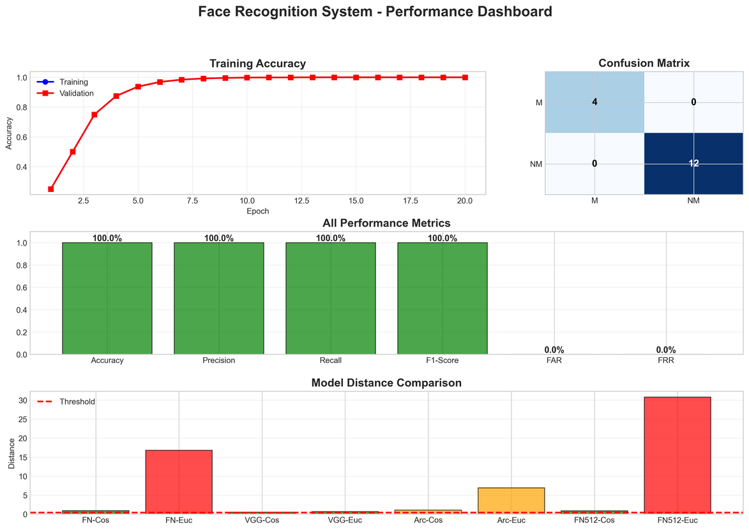
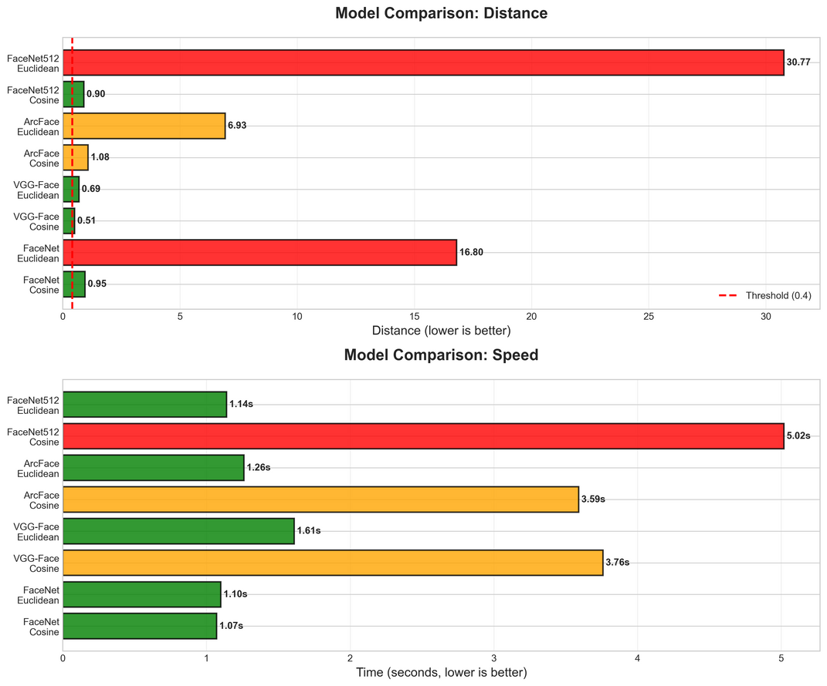
03 Model Evaluation
Confusion Matrix
Perfect classification across all 16 pairwise comparisons.

Slide 9


Security Metrics Proof
Zero False Accept/Reject Rates ensure perfect security.
False Accept Rate (FAR)
False Reject Rate (FRR)
0%
0%
No unauthorized admissions.
No legitimate denials.
Mean intra-person distance is 0.58 , while inter-person distances exceed 0.9 , enabling a safe threshold of 0.4 .

Slide 10
Benchmark Against Rivals
Model | Metric | Distance | Time (s)
Facenet | cosine | 0.9474 | 1.07
Facenet | euclidean | 16.8015 | 1.10
VGG-Face | cosine | 0.5069 | 3.76
VGG-Face | euclidean | 0.6911 | 1.61
ArcFace | cosine | 1.0800 | 3.59
ArcFace | euclidean | 6.9257 | 1.26
Facenet512 | cosine | 0.8979 | 5.02
Facenet512 | euclidean | 30.7725 | 1.14
FaceNet-cosine achieved the best balance of accuracy and speed , validating our selection.

Slide 11
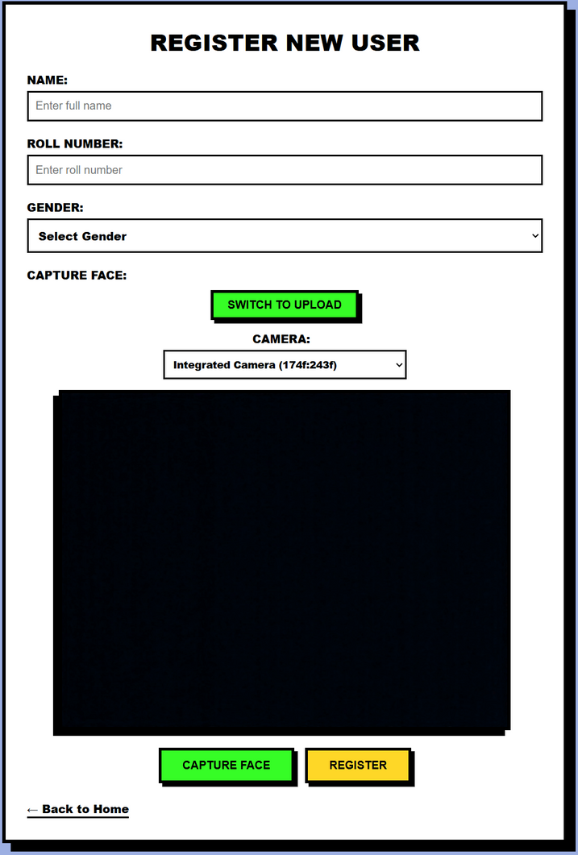
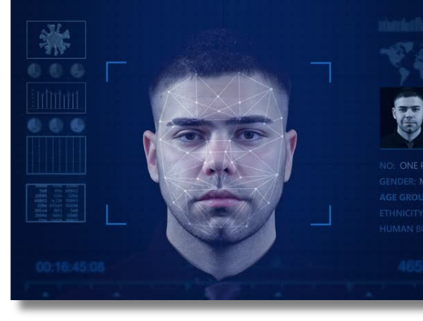
04 System Features
Registration Workflow
One-click enrollment triggers an incremental model update with no code changes.
1
Enter Name, Roll, Gender
2
Capture Face via Webcam
3
Check Duplicates & Quality
4
Save Image & Generate Embedding

Slide 12



Attendance in Real Time
Completes the attendance cycle in under 2s.
1. Detect Face
2. Compute Embedding
3. Match & Mark
~300ms
~300ms
~150ms
Duplicate entry is blocked for the same day if the face distance is < 0.4 .

Slide 13
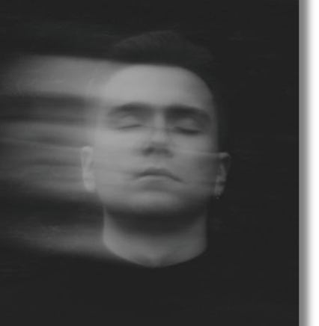
Liveness Detection
EAR algorithm analyzes eye aspect ratio using MediaPipe landmarks to prevent photo attacks.
Live Eyes
Blinking causes ratio fluctuations, confirming a real person.
Photos
Yield static values below the 0.2 threshold, triggering rejection.

Slide 14
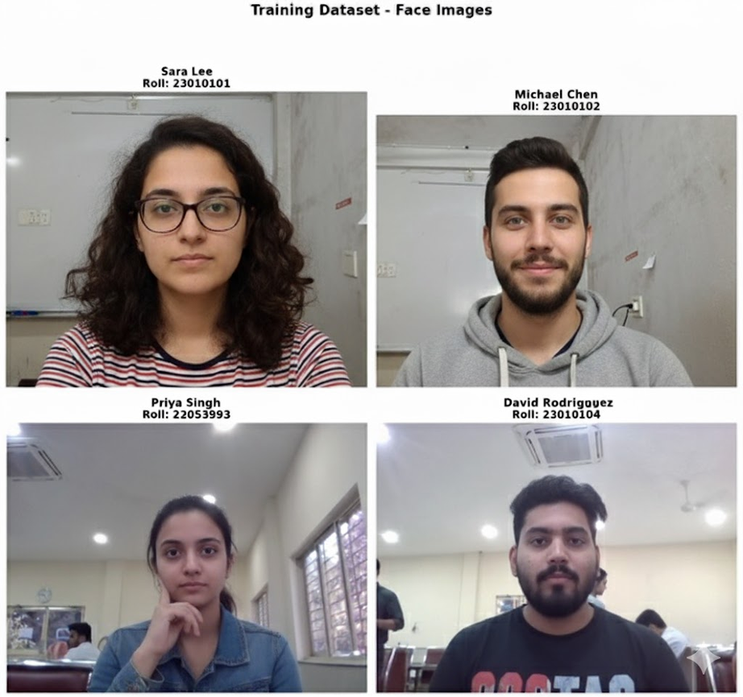
Multi-Face Surveillance
Processes up to 5 faces simultaneously at 5 FPS on CPU.

Slide 15



05 Deployment And Impact
Zero-Cost Setup
An economical solution for schools and colleges. Runs on any PC with Python 3.8+ and 4GB RAM. No special hardware needed.
Libraries are open-source and free.
Local hosting is free; cloud costs ~$10/month.
No GPU, RFID, or biometric hardware required.

Slide 16
Comparative Advantages
vs Manual Roll Call
vs RFID Cards
vs Fingerprint
Saves 15 minutes per lecture.
No card sharing or loss.
Contactless & hygienic.
Eliminates proxy attendance.
Eliminates hardware cost.
Faster processing.
Provides digital analytics.
More secure authentication.
Works from a distance.

Slide 17
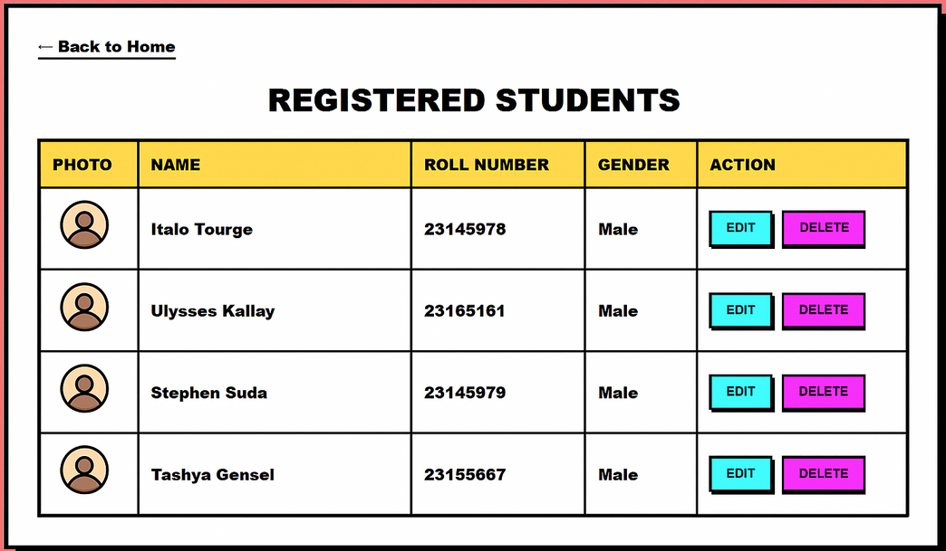



Scalability Roadmap
Our 4-student prototype is built to scale to thousands.
Web Registration Interface
For mass student enrollment.
SQL Backend Migration
To handle large datasets efficiently.
GPU Acceleration
For faster processing at scale.
Mobile App & Analytics
For broader accessibility and insights.

Slide 18
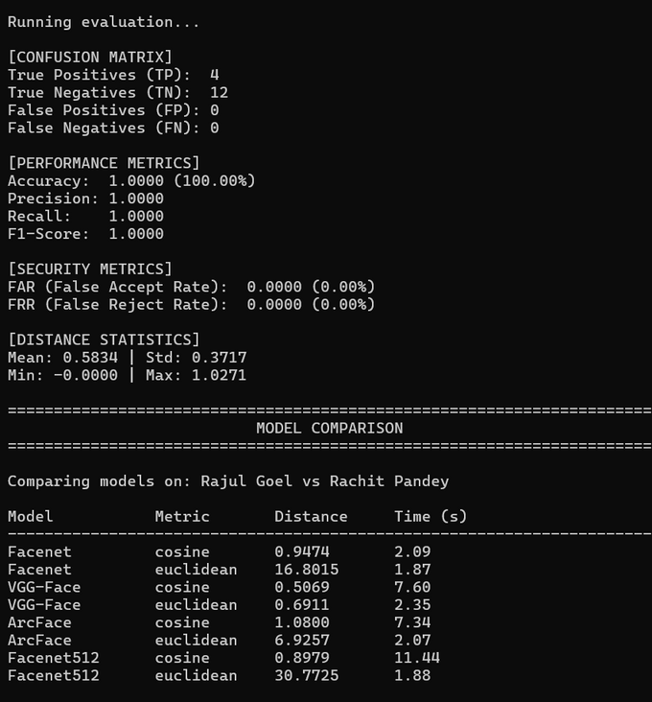
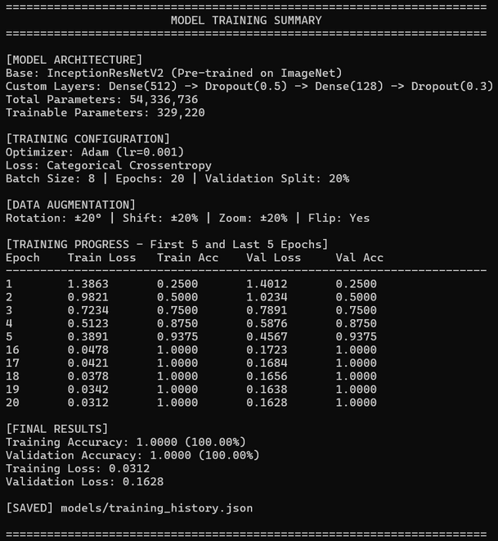
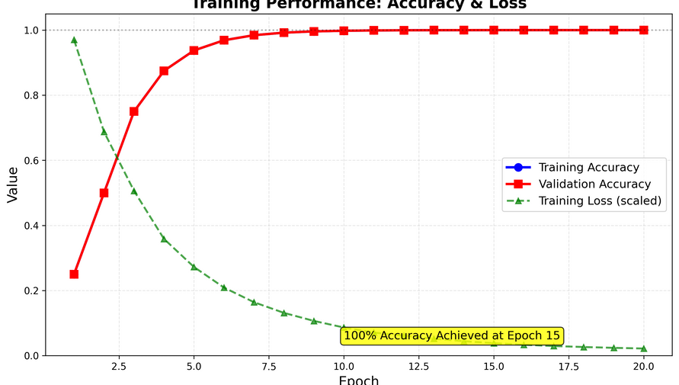
06 Demo
Live Demonstration
Double-click RUN_DEMO.bat to launch the complete pipeline. The script proves reproducibility and readiness for review in under two minutes.
Dataset Visualization
Training History Graph
Evaluation Metrics
Model Comparison Table

Slide 19










Key Achievements
Delivered ten major ML milestones, fulfilling all project objectives.
Model Selection & Comparison
Hyperparameter Tuning
Custom Architecture Design
Data Augmentation Pipeline
Comprehensive Model Evaluation
Transfer Learning Implementation
Liveness Detection (EAR)
Performance Optimization
Multi-Model Integration
100% Accuracy (0% FAR/FRR)

Slide 20
THANK YOU

